Slide 1
GROCERY MANAGEMENT SYSTEM
ICT 2212 – Skill Development Project II
TEAM TECHNO
P.W.D.I.M Rodrigo 1357
H.M.M.A Herath 1313
G.P Rockshan 1356
P.H.M.T Perera 1344
A.R.M Najas 1335

Slide 2
Content
Introduction
Aim and Objectives
Problem Statement
Technical Approach
Work Plan

Slide 3
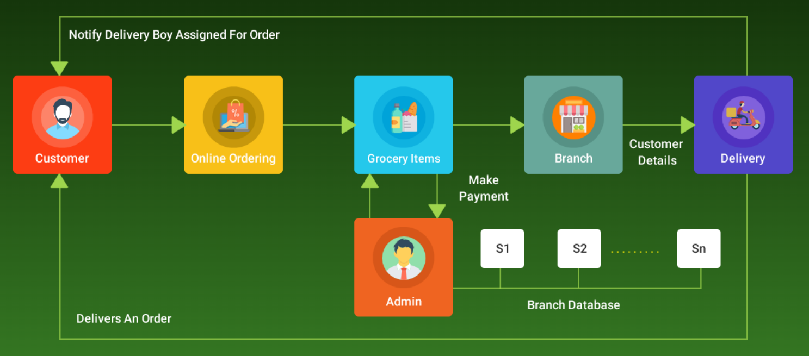
Introduction
A Grocery store management system is the system where all the aspects related to the proper management of a grocery store are done.
These aspects involve managing information about the varied products, staff, customers, billing, etc.
This system provides an efficient way of managing grocery store
information.
Also allows the customer to get and buy the things purchased.

Slide 4
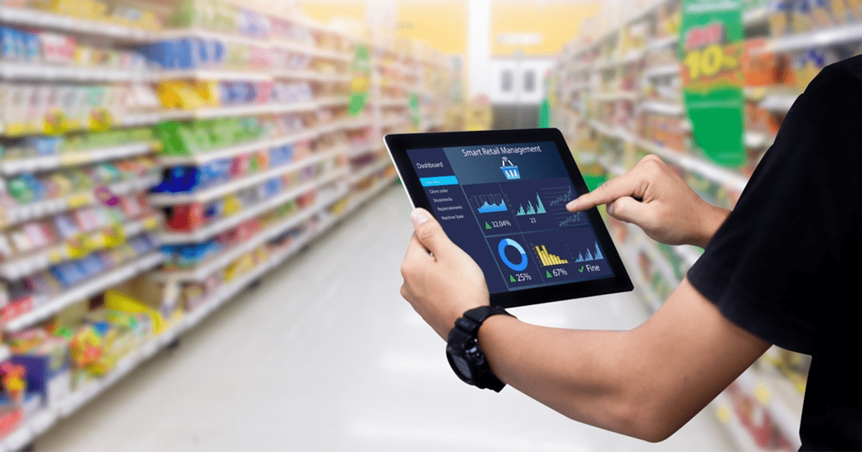
Aim
To provide an advanced system to make the functions of shop (shopping and grocery activities) easy and efficient one with an advanced user friendly system.

Slide 5
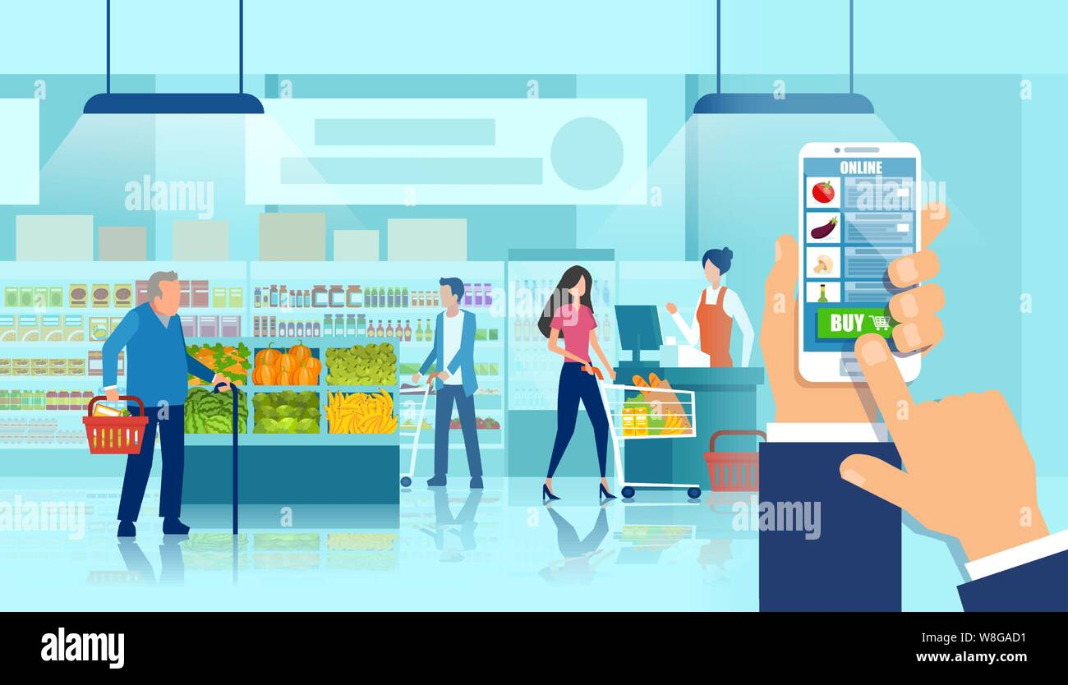
Objectives
Inventory Management
To Sales Tracking
Point of Sale (POS) Operations
To Supplier Management
To Reporting and Analytics
Efficient Billing and Invoicing
To the Security and Data Privacy
To time and cost savings

Slide 6
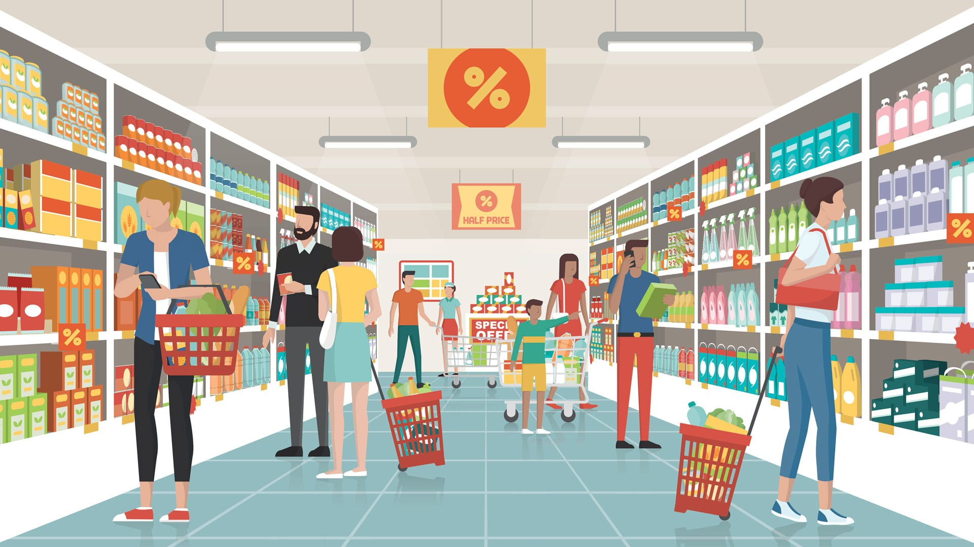
Problem Statement
The factors for these difficulties are:
Time Consumption
Poor Communication
Physical Counts
Daily Purchases
Ordering Supplies

Slide 7



Technical Approach
Using the bellow languages to develop the system.
Java - primary programming language.
Java FX - graphical user interface.
My SQL - data base connection.
Software tools
Scene Builder(Oracle) with NetBeans IDE

Slide 8
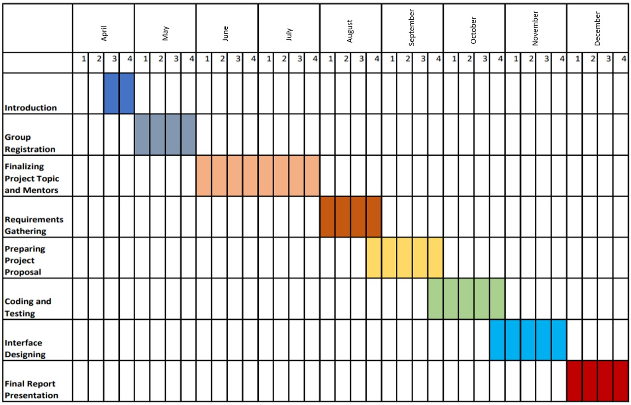
Work plan

Slide 9


Slide 10


